Slide 1
Augmented Reality-based Virtual Tour Guide

Slide 2
PROBLEM STATEMENT
To increase the Tourism to a place (Ex -Rajasthan) using Augmented Reality. There are many heritage sites which lack tourism and many of such sites also do not have Tourist Guides. In such cases tourists didn’t get to know the Culture and history of that properly and communication in language except Hindi and English is always a problem.

Slide 3

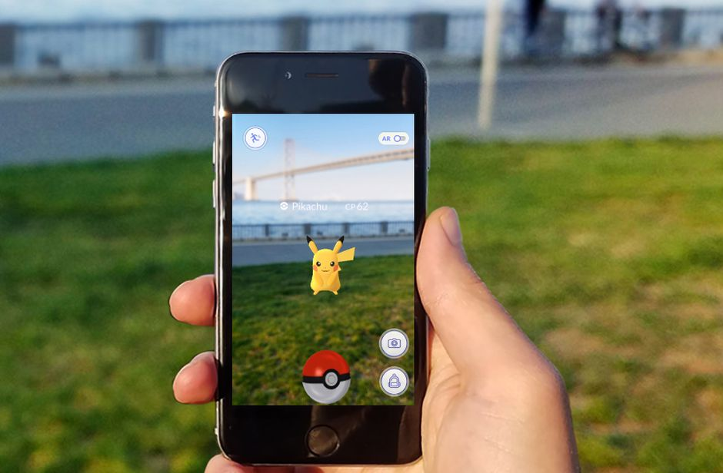
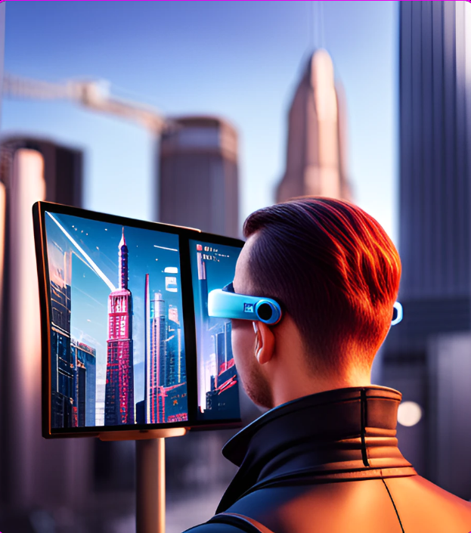
What is Augmented Reality?
The word "augment" refers to the process of improving something by adding to it, which is how the term "augmented reality" is formed. Therefore, augmented reality is essentially a technique for modifying our real world by adding certain digital components to it. This enhances the sense of reality by superimposing a digital image on the person's current vision.

Slide 4
DIFFERENCE BETWEEN AUGMENTED REALITY AND VIRTUAL REALITY
Augmented Reality
Virtual Reality
Augmented reality just adds the virtual components into the user’s real-world view.
For Augmented reality you only need a modern smartphone then you can easily download an AR app like Google’s “just a line” and try this technology.
Virtual reality makes a virtual environment and puts the user in it.
In this, all you have to do is insert a smartphone, wear a headset (like Oculus Rift or a gaming console like PlayStation VR), and immerse yourself in virtual reality.

Slide 5
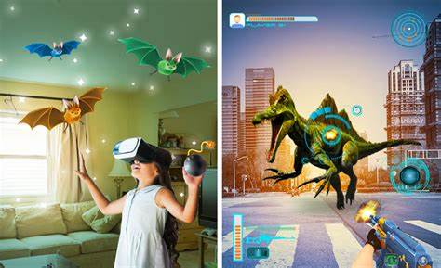

Slide 6
Methodology
Augmented reality offers museums and Cultural Heritage Sites the opportunity to bring history to life

Slide 7
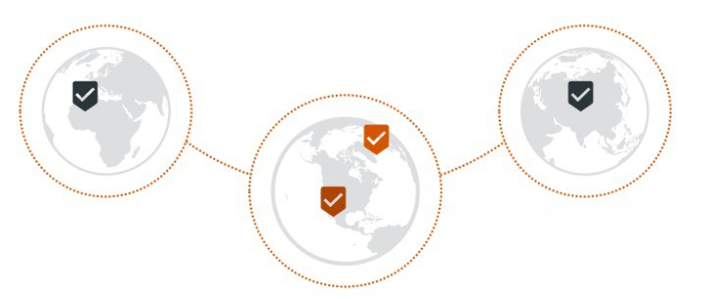
GLOBALIZATION OF CULTURAL HERITAGE
Cultural heritage's tourism business will experience exponential growth. It cannot be done without the use of technology.
With the help of our AR application, we hope to accomplish this. Digitally disseminating Rajasthani culture will lead to revolutionary change.

Slide 8
Working and Features of my App
It will be an android app which will have all relevant details related to tourism i.e., Transportation, Fest & Food, Luxury Tour Packages etc.
User can create his tour plan in this app. When s/he visits some place s/he just needs to play tour of that place.
As soon as user plays tour, AR version of application will open. It will navigate the user. The user can see 3D models of monuments, descriptions of different artifacts/paintings through voice and text.
There will be unique QR-codes scanning which will open an AR virtual guide. It will narrate the information in users’ preferable language.
When the user will point camera at any object/painting it will create 3-D model of that.

Slide 9
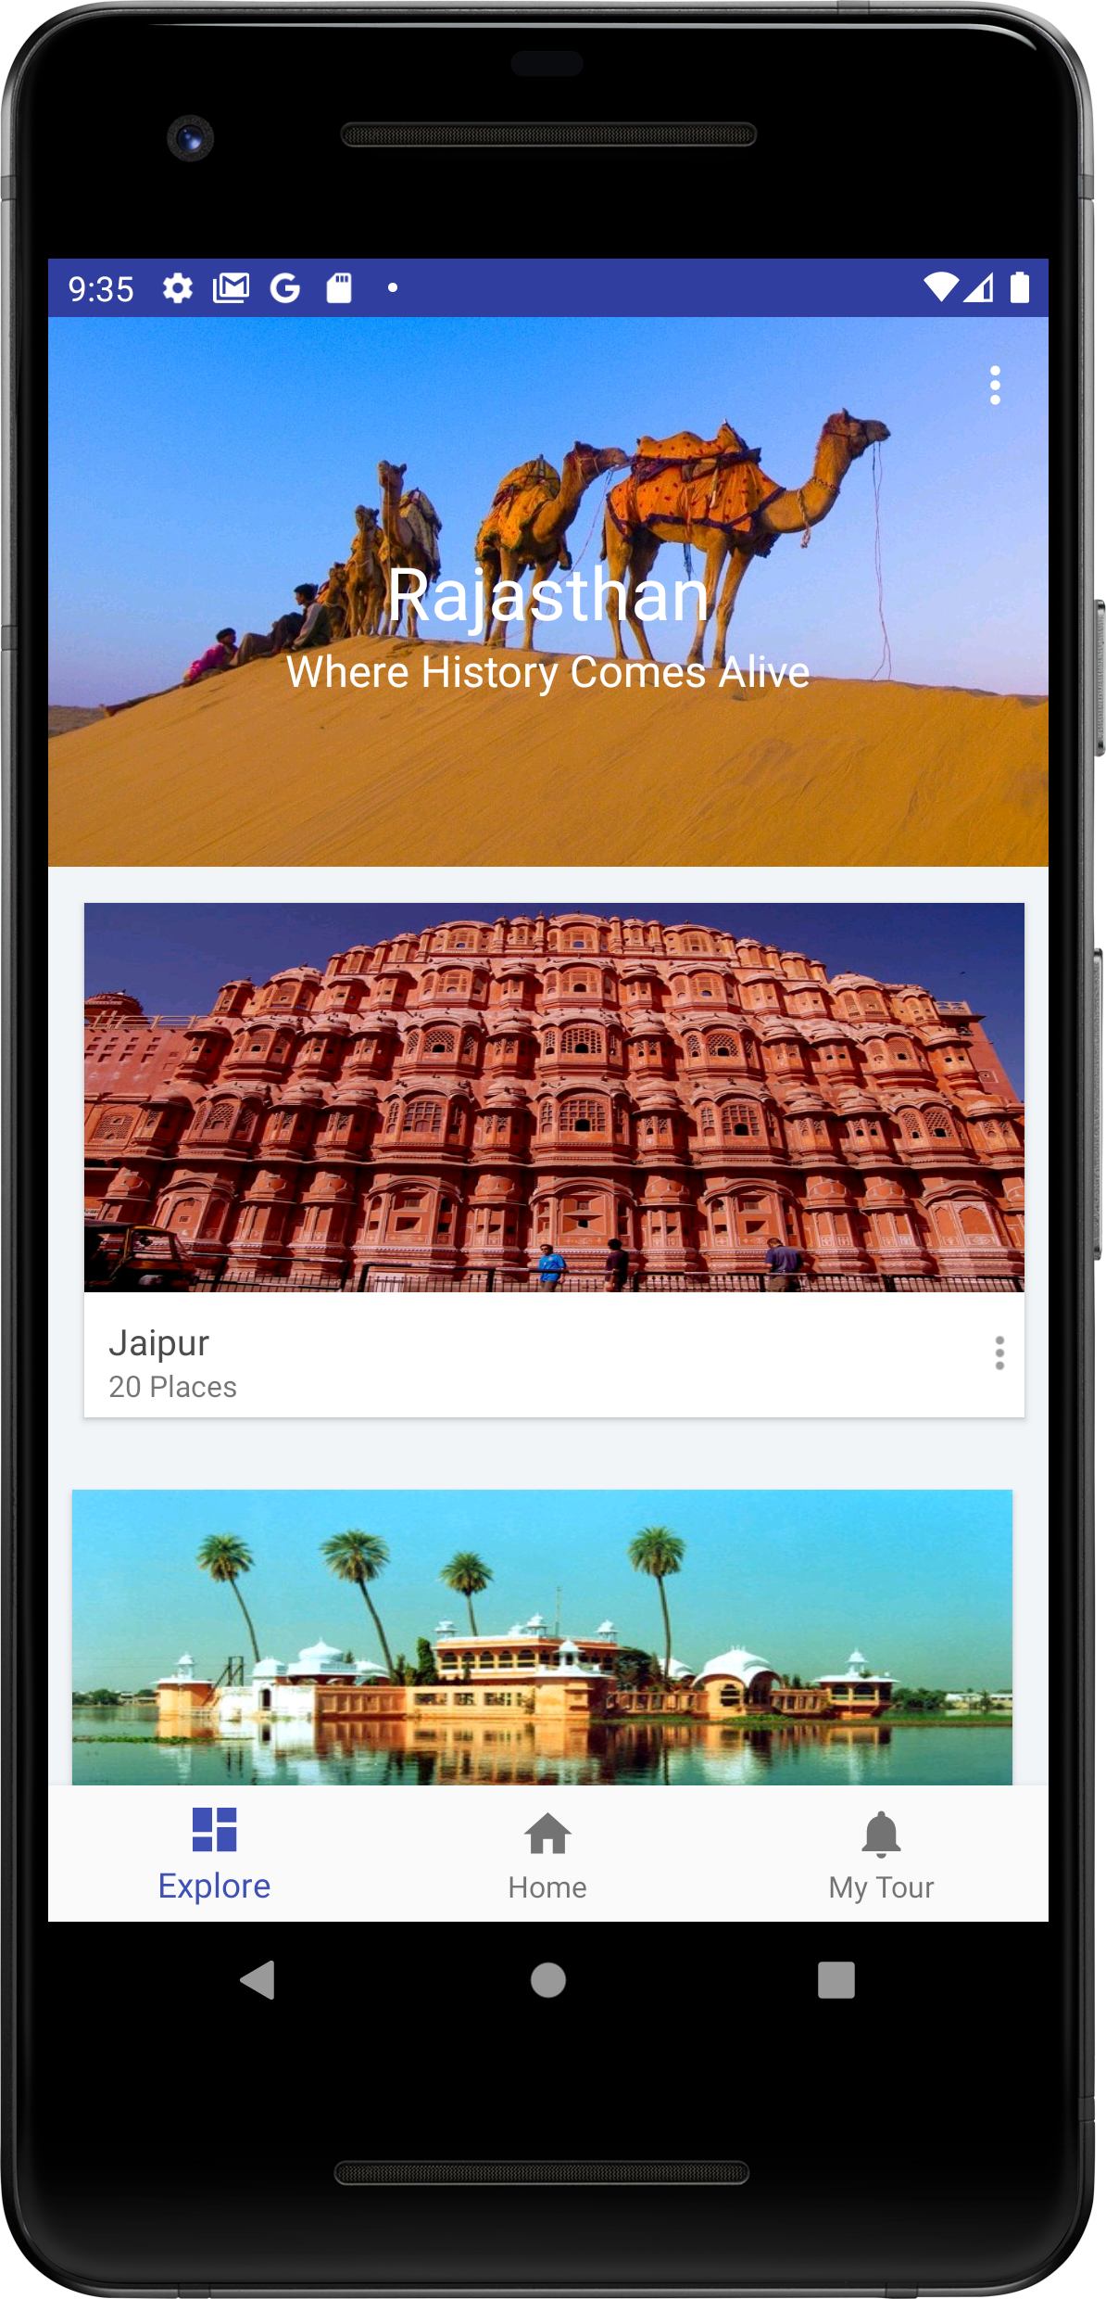
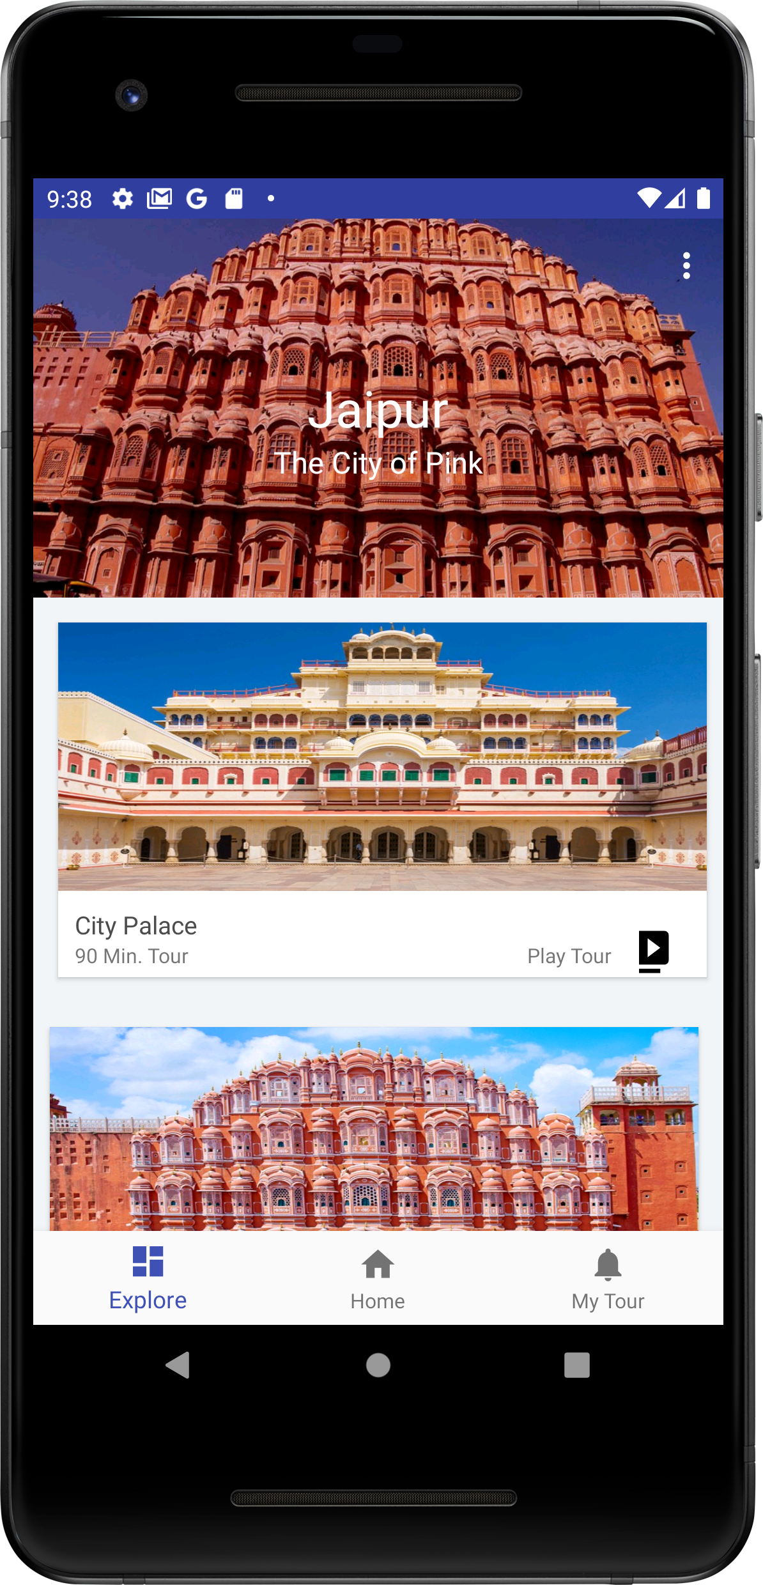
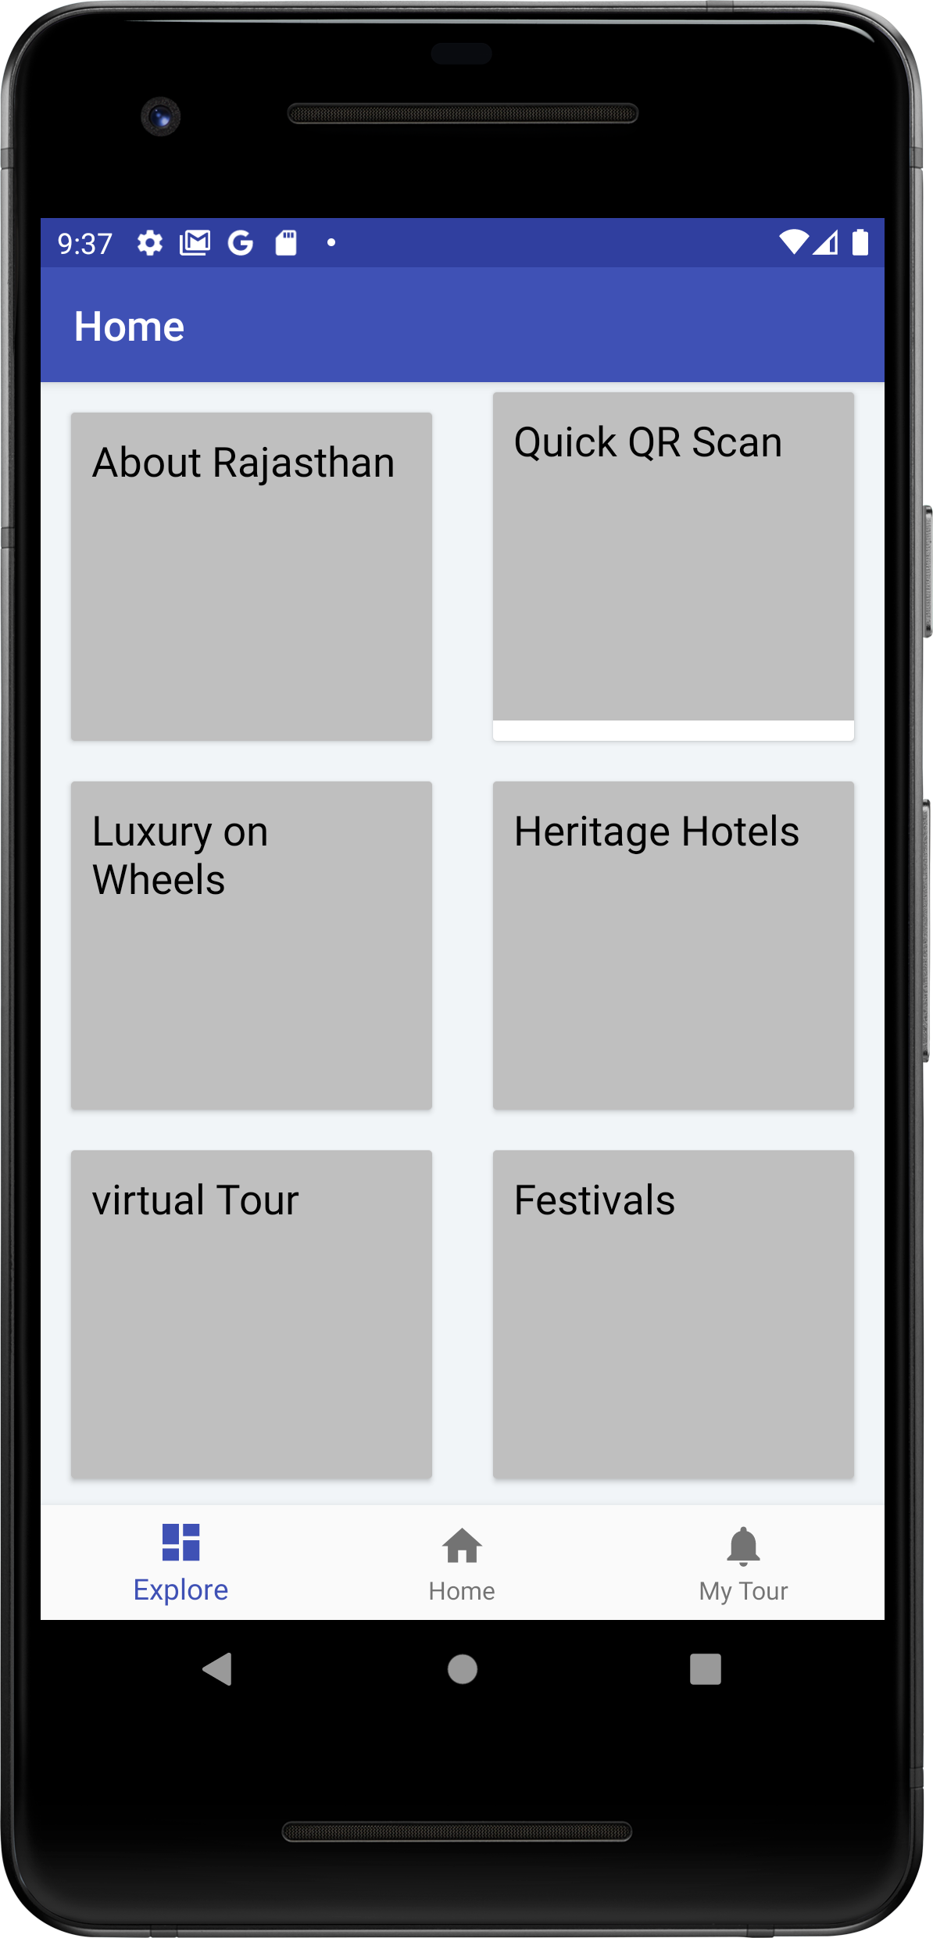
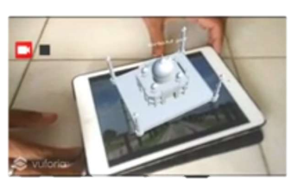
RESULT AND DISCUSSION
Here the above Interface for tourism application is implemented in Android Studio with the help of JAVA programming language the images of various Heritage sites are taken from google just to represent various places which can be visited by a tourist in Rajasthan.
I had given three main activities to give basic functionalities in the application. From these, tourists will be able to make their whole plan to visit the various places among Rajasthan and can have a virtual tour of the place using Augmented Reality by clicking Play Tour icon.
Here the above Augmented Reality app which displays the model of Taj Mahal is made in Unity Editor along with Vuforia Engine.
It also used the image tracking feature of unity to overlay the 3D Model over the displayed image.
After Displaying 3D model over the image, it will also narrate the history of that heritage site and will stop narrating when the image is removed from tracking AR Camera.

Slide 10
FUTURE WORK
To integrate each Heritage site with the entire AR app. in order for the tourist guide to be available everywhere.
To make more 3D models available in applications, as there aren't many of them for heritage sites.
Increase the application's functionality to allow users to see their complete tour itinerary for a certain location.
360-degree tours of surrounding restaurants and hotels should be added so that users may make their own decisions.
For better identification of Heritage sites, integrate it with the official tourism website.
a complete transaction functionality that enables travelers to find a one-stop solution to all their problems.
Luxury and vehicles from companies should be included so that transportation do not become an issue.

Slide 11
THANK YOU

